Slide 1

Global Trends in Mental Health Disorders HIT-750 (Data Analytics) Prof : Dr. Isaac Mativo
Team-3:
Mounika Atmakuri,
Sridhar Reddy Maram,
Everet Thokozani Kalongonda,
Shriya Kandikonda Venkatadri

Slide 2


Table of CONTENTS
Overview of the topic
Importance of the topic
Research facts
Online References & Key Findings
Statistical plots from online references
Facts from scholarly research references
Dataset overview
Types of Mental Disorders
Contents of the Dataset
Basic analysis in R-Code
References

Slide 3
Overview of the Topic
Approximately 1 in every 8 people worldwide live with a mental disorder.
Mental health impacts work, relationships, and community engagement.
Many individuals do not receive proper care due to stigma and lack of resources.
Data collection is crucial to understanding trends and improving treatments.

Slide 4
Importance of the Topic
Mental health disorders impact well-being, productivity, and society.
Understanding trends aids in developing prevention and treatment strategies.
Analysis informs policy-making and healthcare practices.
Reducing stigma encourages mental health awareness and support.

Slide 5
Research Facts on Mental Illness
1 in 3 women and 1 in 5 men experience major depression.
COVID-19 led to 53M new depression cases and 76M anxiety cases.
Mental health issues peak in early adulthood.
Despite available treatments, accessibility remains a challenge.

Slide 6
Online References & Key Points
Our World in Data: Mental Health
It explores the burden of mental illnesses, showing how they impact individuals, families, and society as a whole.
Another key focus is on public attitudes toward mental health, emphasizing the need to break the stigma and encourage open conversations.
WHO: Mental Disorders
It shares key statistics, including the striking fact that 1 in 8 people worldwide live with a mental health condition.
A major issue it raises is the gap in mental health care, as many people do not get the support they need due to limited resources.

Slide 7
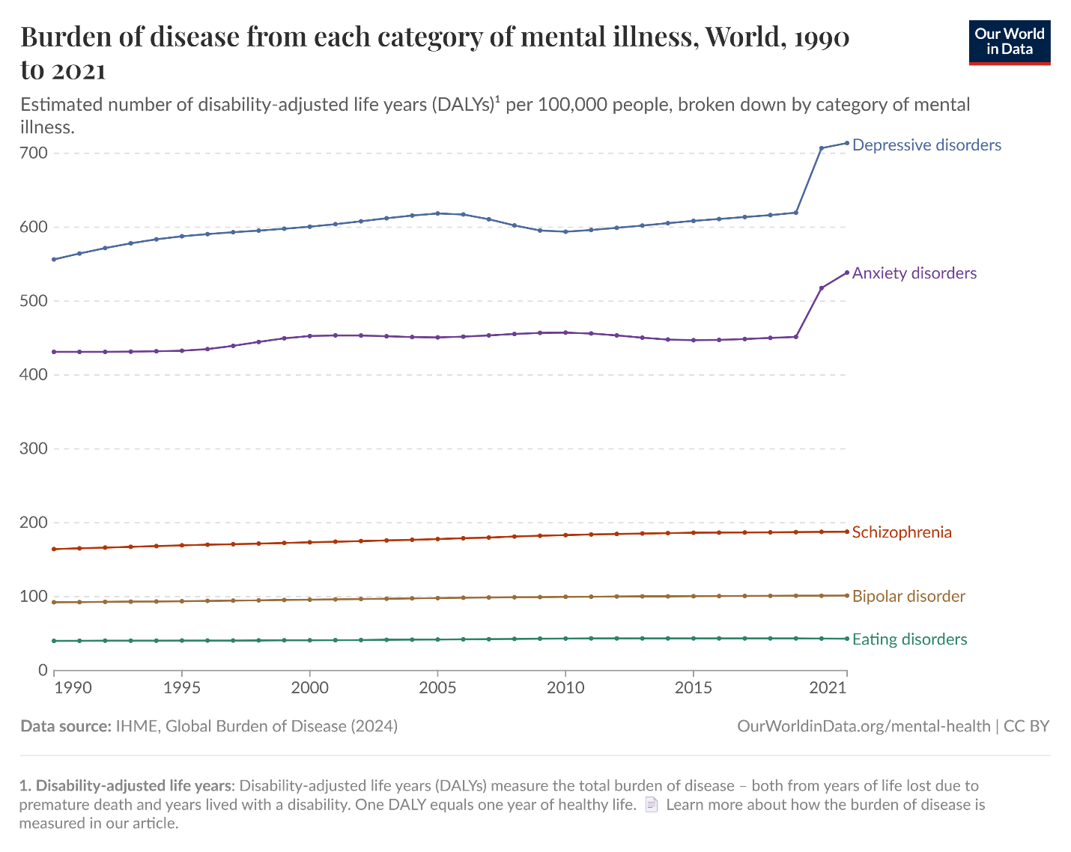
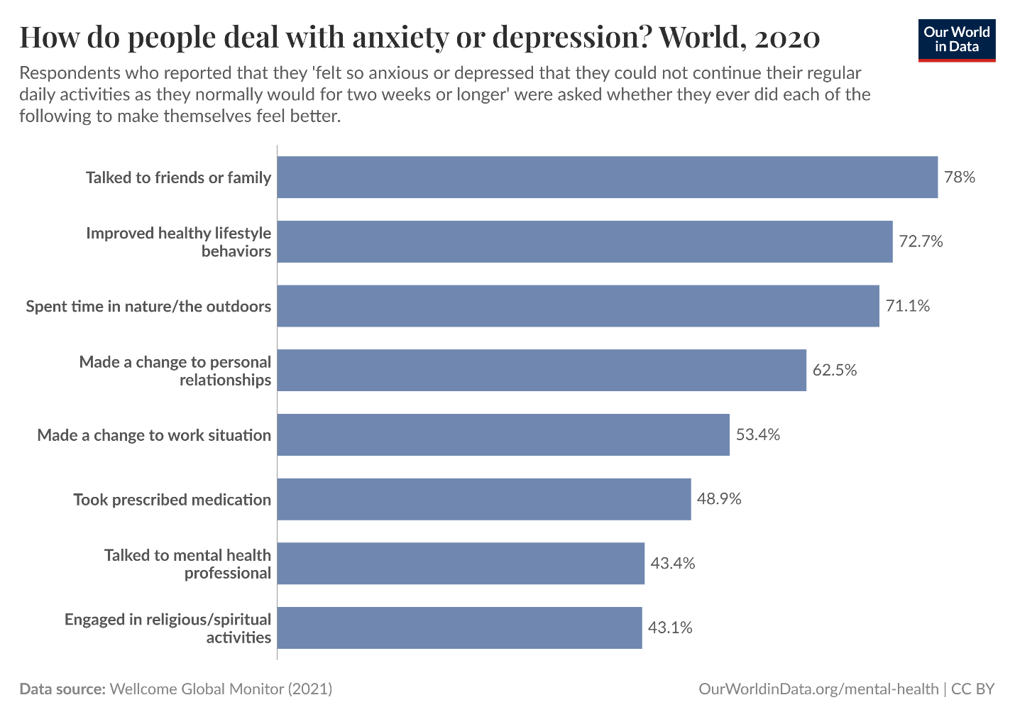
Plots from Online References
Fig 1 : Line chart for the distribution of Mental Disorders
Fig 2 : Distribution pattern for overcoming Anxiety or Depression

Slide 8
Scholarly Research References
Changing Trends in Mental Disorders (Wu et al., 2023)
Cases rising due to population growth.
Peaks in early adulthood, declines with age.
Calls for stronger mental health policies.
Impact of COVID-19 on Mental Health (2021)
53M new depression & 76M anxiety cases.
Women & youth most affected.
Exposed major gaps in mental healthcare.

Slide 9
Dataset Overview from Kaggle
The dataset titled "Global Trends in Mental Health Disorder" is available on Kaggle
Saloni Dattani, Lucas Rodés-Guirao, Hannah Ritchie and Max Roser (2023) - “Mental Health” Published online at OurWorldinData.org. Retrieved from: 'https://ourworldindata.org/mental-health' [Original Online Resource]
Data includes:
- Country/Region
- Year
- Prevalence of mental health disorders

Slide 10

Types of Mental Disorders
Schizophrenia
Bipolar disorders
Eating disorders
Anxiety disorders
Drug use disorders
Depression
Alcohol use disorders

Slide 11
contents of the dataset
Entity – The country or region being analyzed.
Code – The standardized country code.
Year – The year of data collection.
Schizophrenia (%) – The percentage of the population diagnosed with schizophrenia.
Bipolar Disorder (%) – The percentage of individuals with bipolar disorder.
Eating Disorders (%) – The prevalence of eating disorders.
Anxiety Disorders (%) – The percentage of people experiencing anxiety disorders.
Drug Use Disorders (%) – The proportion of the population with substance abuse disorders.
Depression (%) – The prevalence of depression in the population.
Alcohol Use Disorders (%) – The percentage of individuals affected by alcohol-related disorders.

Slide 12
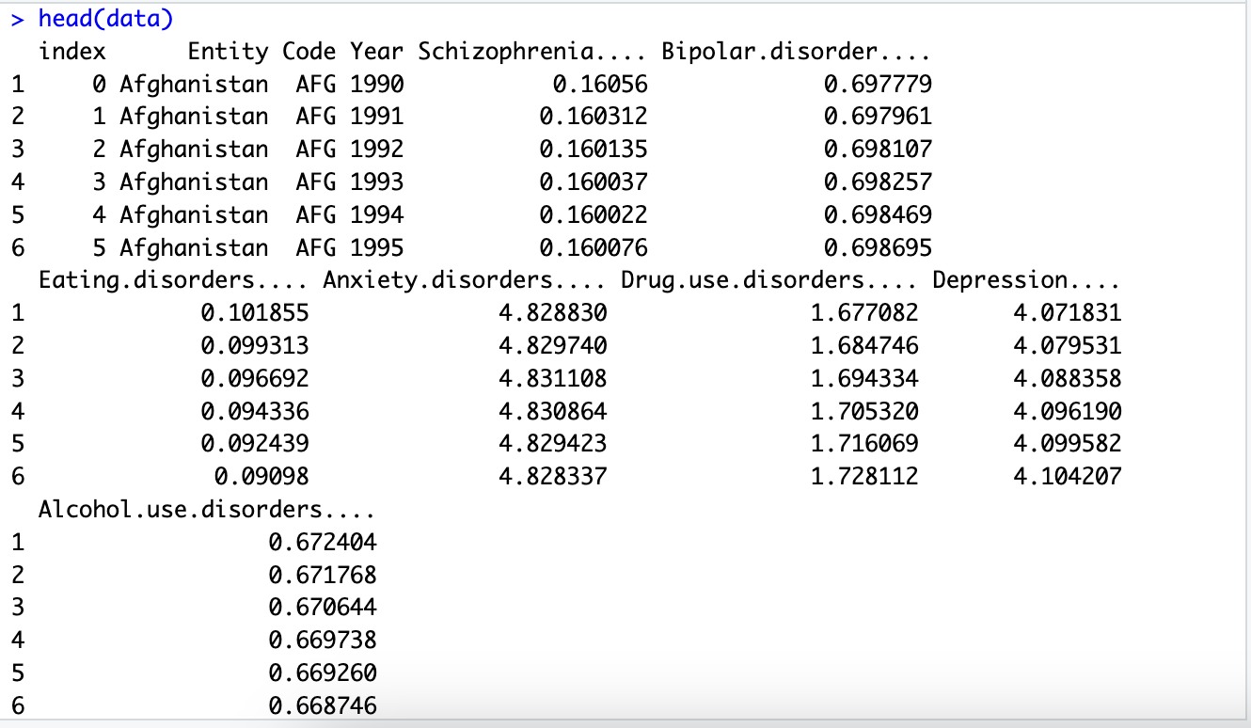
Loading csv file into R studio
Data Analysis
setwd("/Users/mounikaatmakuri/Downloads/750_Data_Analytics")
getwd()
data <- read.csv("Mental_health_Depression_disorder_Data.csv")
head(data)

Slide 13
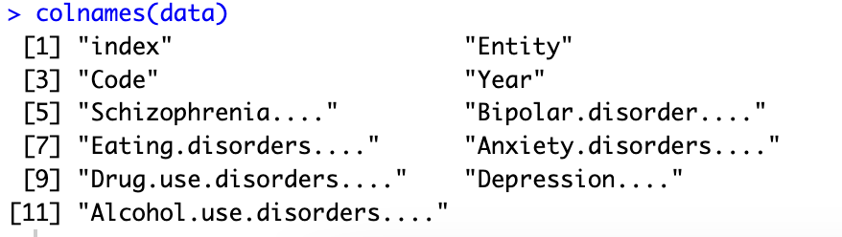
Display the Column names
Data Analysis
colnames(data)

Slide 14
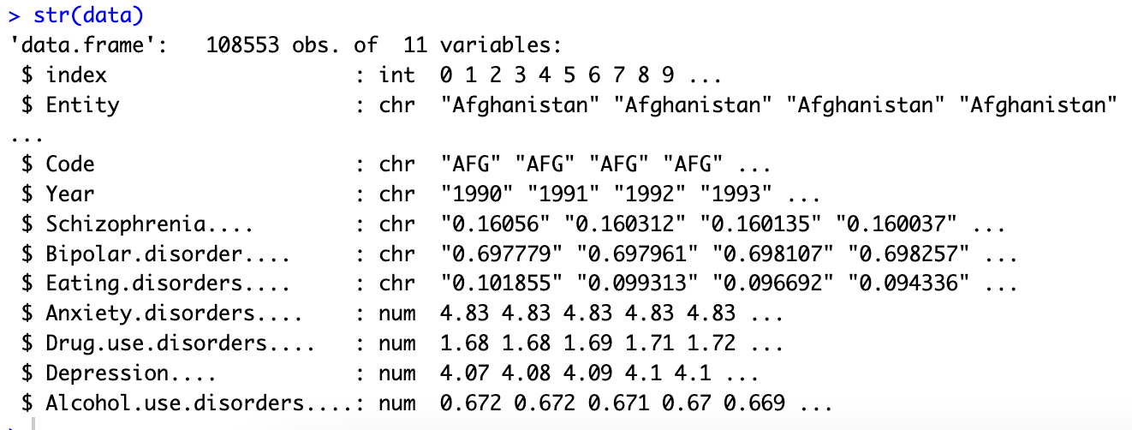
Display the structure of the data
Data Analysis
str(data)

Slide 15
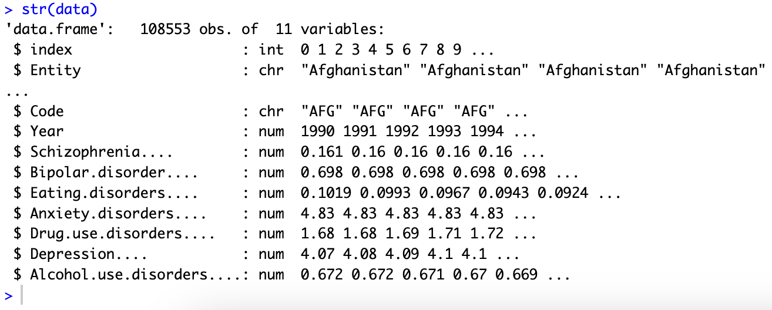
Converting data types for columns
Data Analysis
columns_to_convert <- c("Year", "Schizophrenia....", "Bipolar.disorder....", "Eating.disorders....")
data[columns_to_convert] <- lapply(data[columns_to_convert], as.numeric)
str(data)

Slide 16
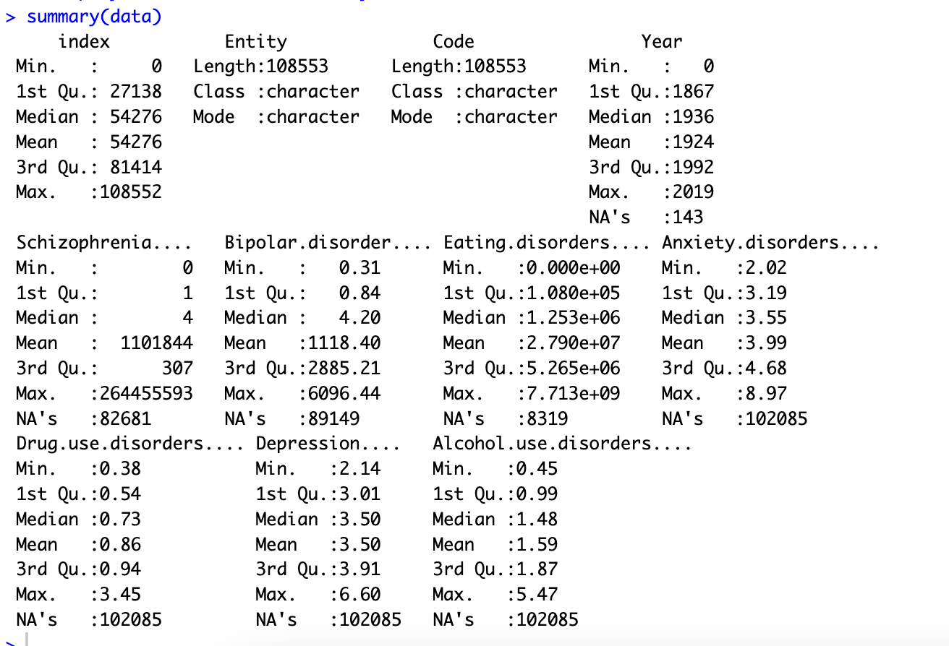
Display the statistical summary
Data Analysis
summary(data)

Slide 17
Check for duplicates
Data Analysis
total_duplicates <- sum(duplicated(data))
cat("Total duplicate rows:", total_duplicates)
# Remove duplicates
# data <- distinct(data)

Slide 18
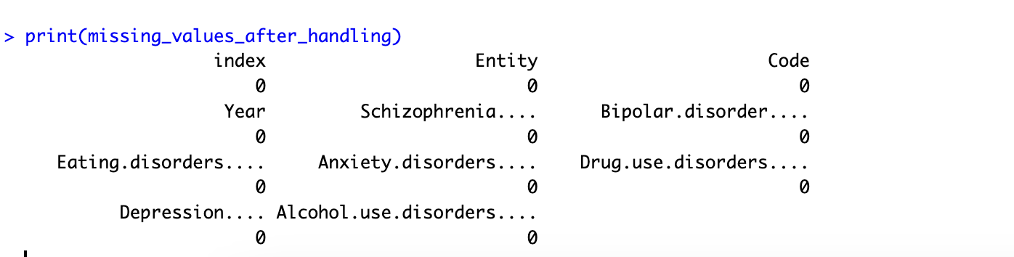
Handling Missing Values
Data Analysis
missing_values <- colSums(is.na(data))
# Drop rows where data is missing in specific columns
selected_columns <- c("Code", "Year",
"Schizophrenia....", "Bipolar.disorder....",
"Eating.disorders....", "Anxiety.disorders....",
"Drug.use.disorders....", "Depression....",
"Alcohol.use.disorders....")
# Drop rows where data is missing in specific columns
data <- data[complete.cases(data[, selected_columns]), ]
# Display missing values after handling
missing_values_after_handling <- colSums(is.na(data))
cat("Missing values after handling:\n\n")
print(missing_values_after_handling)

Slide 19
Countries present in Data set
Data Analysis
ggplot(top_entities, aes(x = reorder(Entity, -Frequency), y = Frequency, fill = Entity)) +
geom_bar(stat = "identity") +
theme_minimal() +
labs(title = "Top 20 Entities by Frequency", x = "Entity", y = "Count") +
theme(axis.text.x = element_text(angle = 90, hjust = 1))

Slide 20
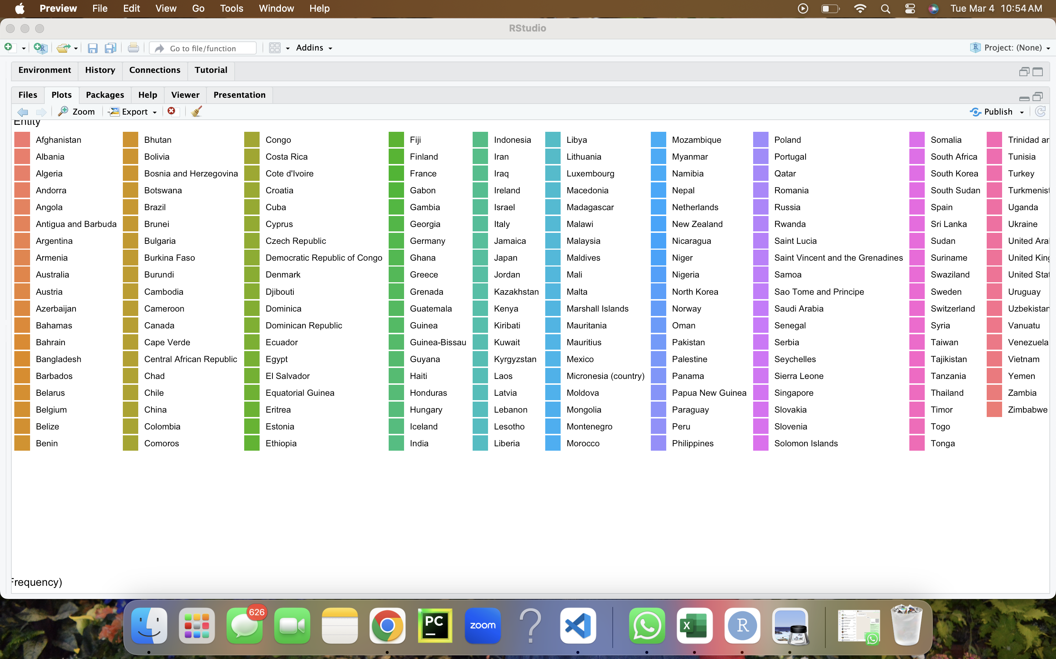

Slide 21
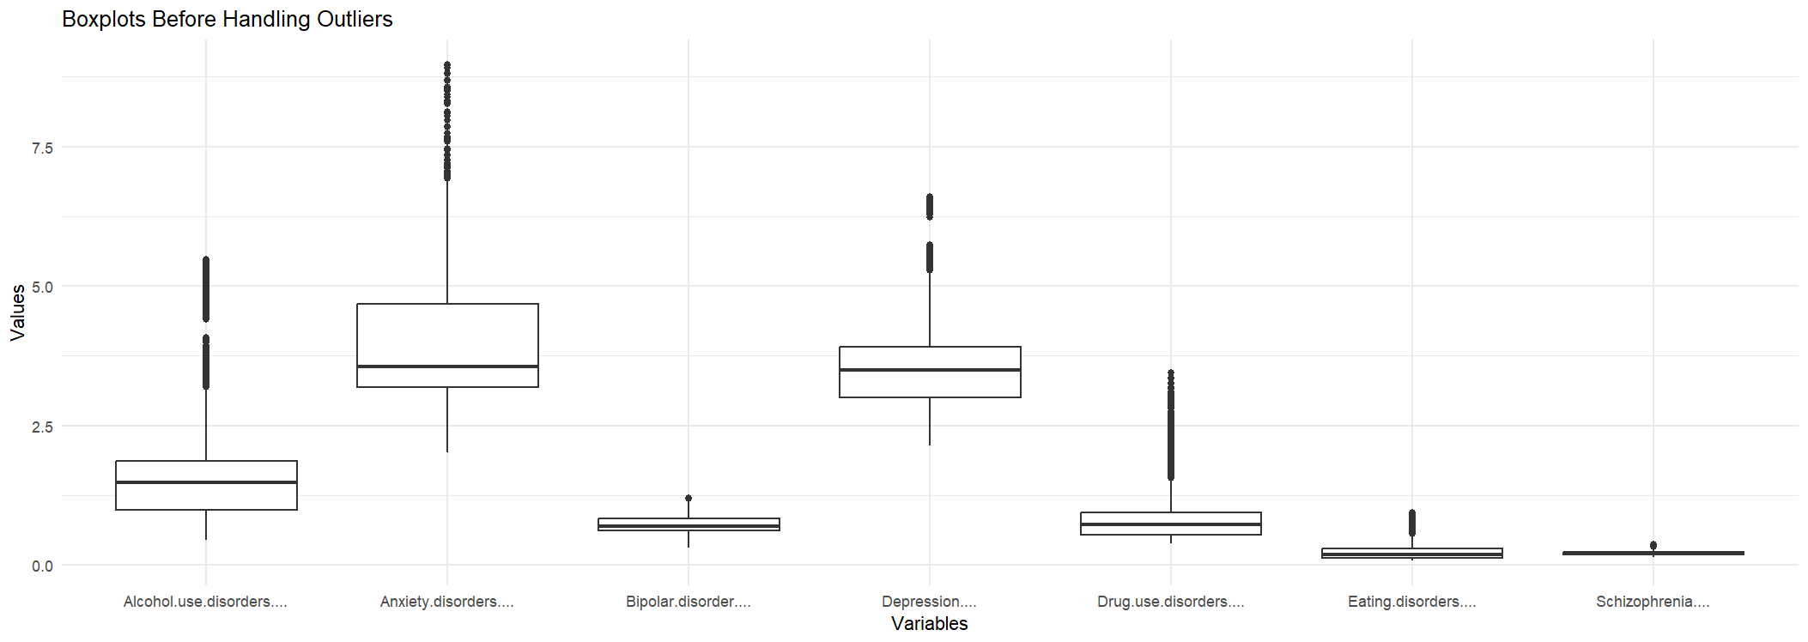

Slide 22
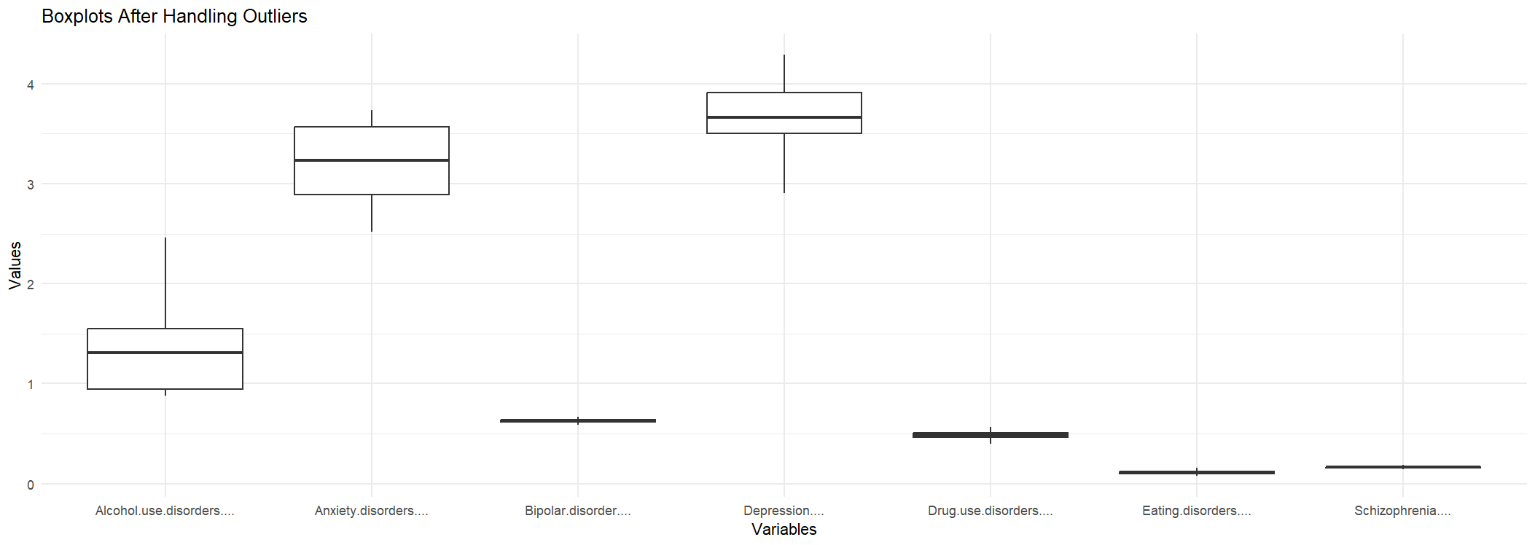

Slide 23
references
Dattani, S., Rodés-Guirao, L., Ritchie, H., & Roser, M. (2023, June 20). Mental health. Our World in Data. https://ourworldindata.org/mental-health
World Health Organization: WHO. (2022, June 8). Mental disorders. https://www.who.int/news-room/fact-sheets/detail/mental-disorders
COVID-19 Mental Disorders Collaborators, & Santomauro, D. (2021). Global prevalence and burden of depressive and anxiety disorders in 204 countries and territories in 2020 due to the COVID-19 pandemic. In The Lancet (Vol. 398). https://doi.org/10.1016/S0140-6736(21)02143-7
Wu, Y., Wang, L., Tao, M., Cao, H., Yuan, H., Ye, M., Chen, X., Wang, K., & Zhu, C. (2023). Changing trends in the global burden of mental disorders from 1990 to 2019 and predicted levels in 25 years. Epidemiology and Psychiatric Sciences, 32. https://doi.org/10.1017/s2045796023000756
Global Trends in Mental health Disorder. (2022, December 14). Kaggle. https://www.kaggle.com/datasets/thedevastator/uncover-global-trends-in-mental-health-disorder

Slide 24


